Slide 1

Reinforcement Learning Automated Stock Trading

Slide 2

INTRO
INTRO
Automated Trading Systems (ATS) leverage Reinforcement Learning (RL) agents to learn optimal trading strategies in dynamic financial markets with multiple stocks.

Slide 3

BENEFITS
benefitS
Efficiency
scalability
Automates trading decisions and execution, processing vast amounts of data quickly
Easily scalable to manage and analyze data from multiple markets or instruments simultaneously
Emotional bias
adaptability
Eliminates emotional biases, making decisions based on data and predefined strategies
Can learn and adapt to new patterns or changes in the market, potentially improving strategies over time
Irregular hours Operation
Excel in capturing market price movements and executing trades promptly, going beyond human limitations in continuously monitoring the market

Slide 4

MODEL OVERVIEW
agent
environment
Simulates the financial market
Trained models
state
action
Historical price
Buy / Sell / Hold
reward
Amount of profit

Slide 5
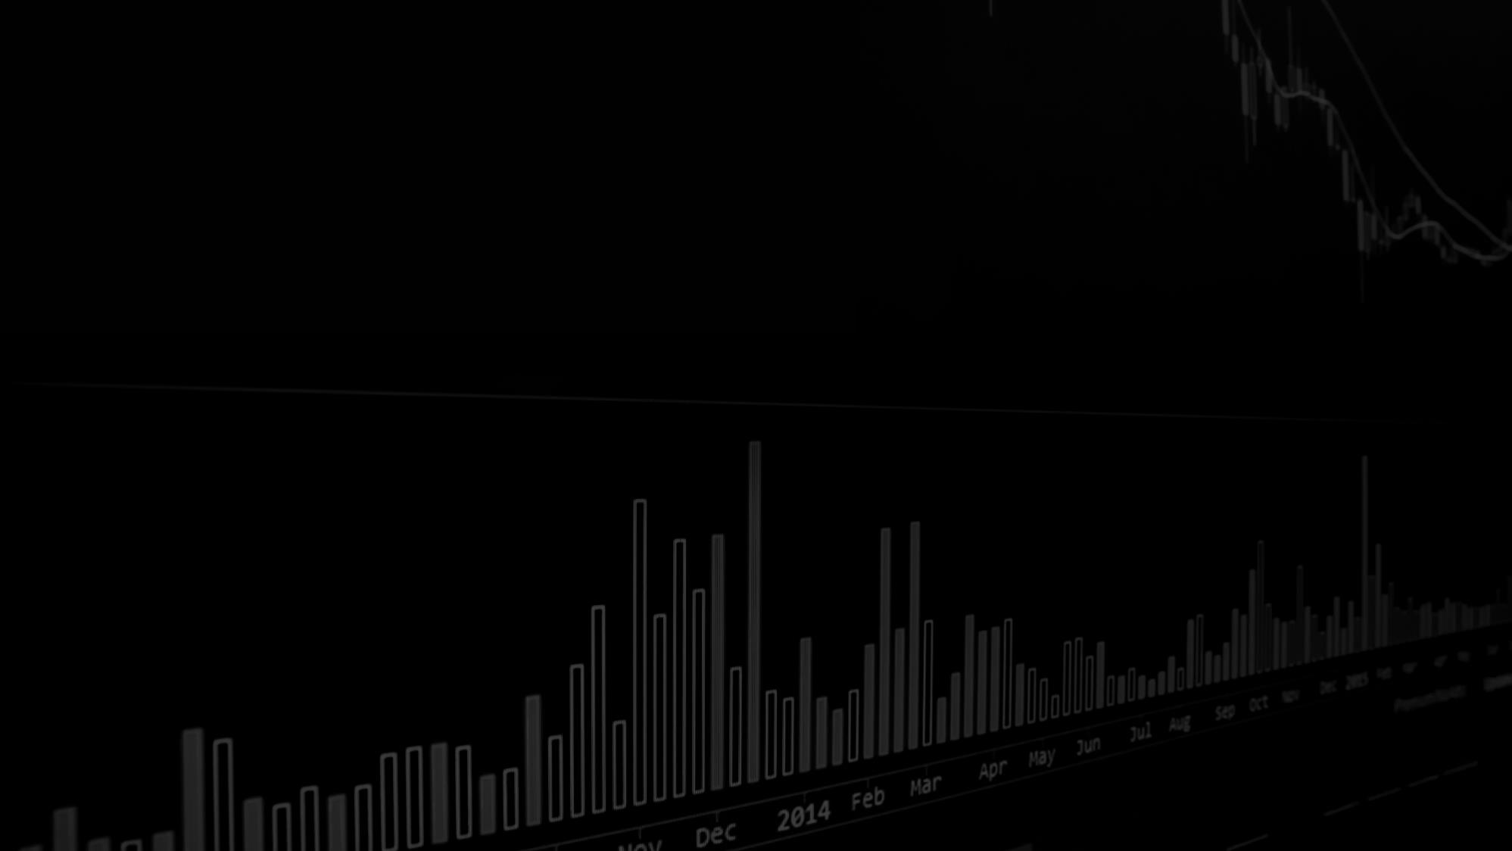
ENVIRONMENT
Balance
Technical Indicators
Stock
Price
Shares

Slide 6
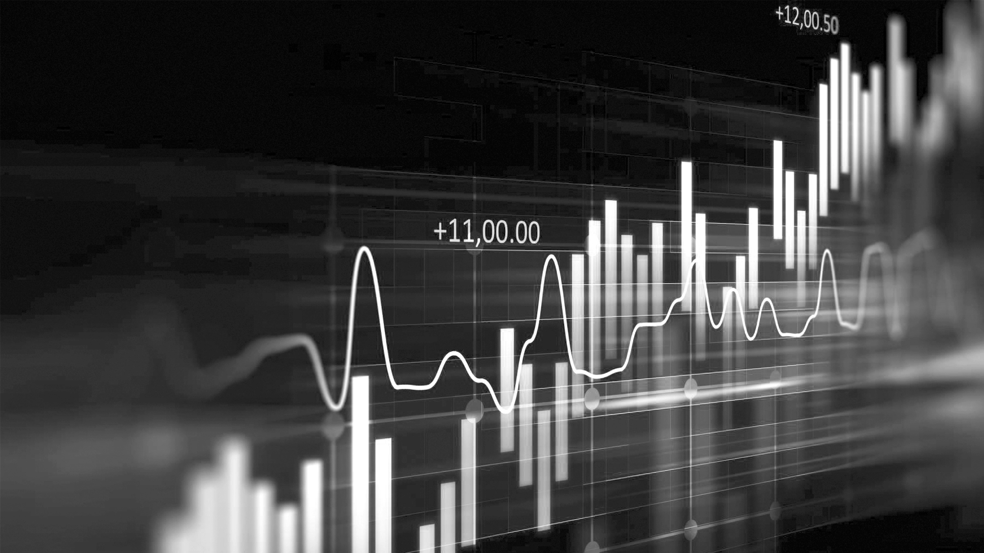
DATASET OVERVIEW
TSX?
IDX?
NYSE!
CFMRC/TSX Database Annual Update
Dataset Saham Indonesia / Indonesia Stock Dataset
USA 514 Stocks Prices NASDAQ NYSE
Notes:
References:
TSX: CHASS Data Centre (uwo.ca)
IDX: https://www.kaggle.com/datasets/muamkh/ihsgstockdata
NYSE: https://www.kaggle.com/datasets/olegshpagin/usa-stocks-prices-ohlcv/data

Slide 7
STOCK DATA SPLITTING
Training & Validation
Jun 22 - Jun 23
2022/01
JAN
FEB
MAR
APR
MAY
JUN
JUL
AUG
SEP
OCT
NOV
DEC
2023/12
JAN
FEB
MAR
APR
MAY
JUN
JUL
AUG
SEP
OCT
NOV
DEC
Trading
20XX
Jul 23 - Dec 23

Slide 8

ALGORITHMS

Slide 9

Algorithms
Advantage Actor Critic (A2C)
Combines value-based and policy-based RL, using the critic to estimate the value function and the actor to update the policy direction
Deep Deterministic Policy Gradient (DDPG)
Model-free, off-policy actor-critic algorithm, using deep function approximators, learn policies in high-dimensional, continuous action spaces
Proximal Policy Optimization (PPO)
Improves stability and efficiency of policy gradient methods by limiting the amount each update changes the policy
Notes:
The main difference lies in their approach to balancing exploration and exploitation, handling continuous action spaces, and efficiency in learning. A2C synchronously updates policies, DDPG focuses on continuous action spaces with deterministic policies, while PPO restricts policy updates to avoid large deviations, enhancing stability.

Slide 10

COMPARISON
We are considering metrics like Sharpe Ratio (risk-adjusted returns), total return, drawdown (peak to trough decline), and the win-to-loss ratio.
COMPARISON

Slide 11

LIMITATIONS
How to improve in the future
Data quality
Market dynamics
Regulatory
Limited index selection
could result in missed opportunities or increased exposure to risk
Financial markets are complex and influenced by unpredictable factors that models may not account for
Navigating financial regulations and compliance requirements can be complex

Slide 12

Thank You

